Slide 1
Illegal Drugs

Slide 2
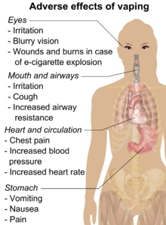
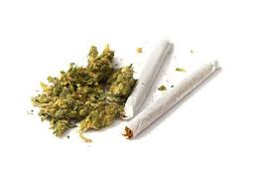
Marijuana

Slide 3
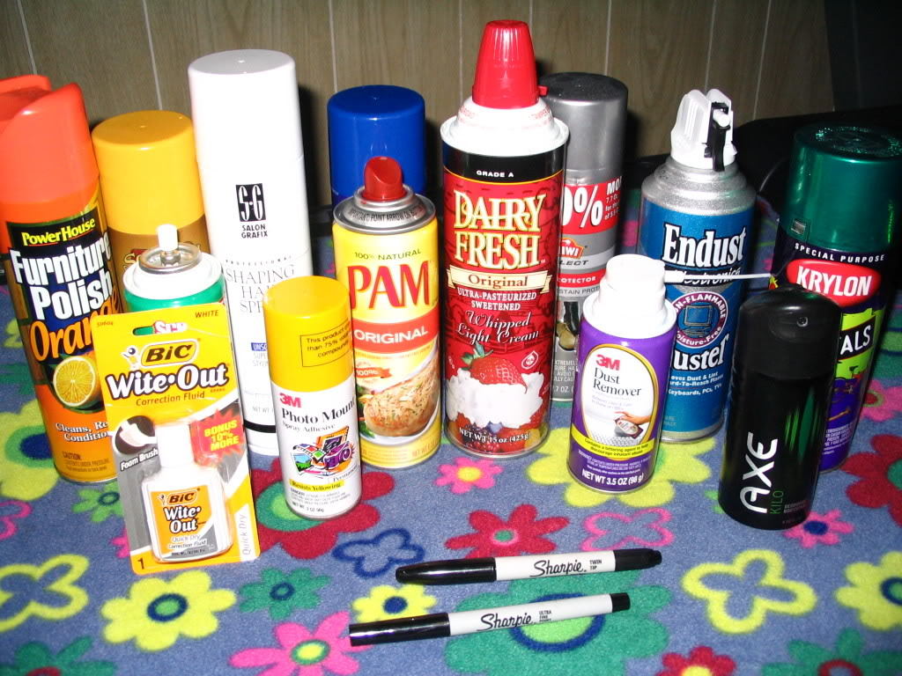
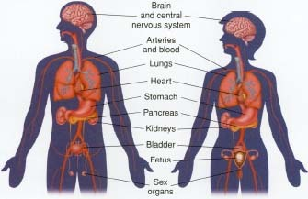
Inhalants

Slide 4
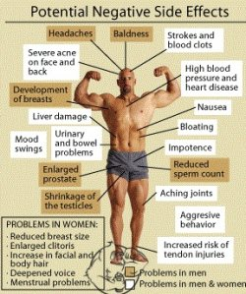
Anabolic Steroids

Slide 5
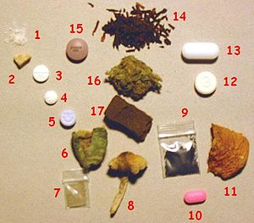
Psychoactive Drugs

Slide 6
Methamphetamine

Slide 7
Heroin

Slide 8
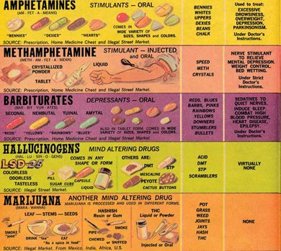
Chart

