Slide 1
Tobacco/Alcohol

Slide 2
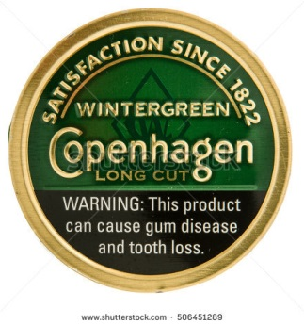
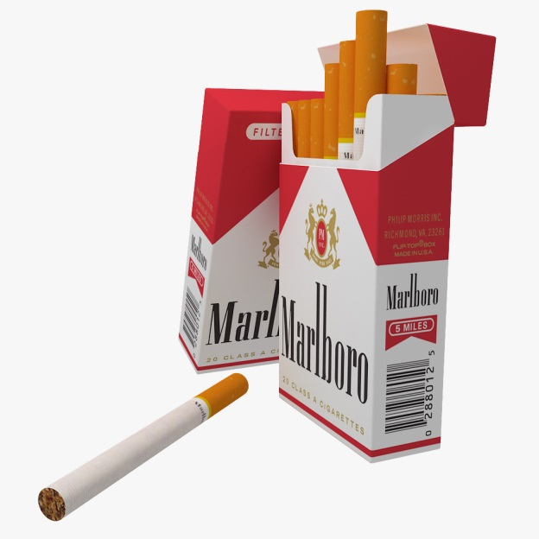

Slide 3
Lungs

Slide 4
Vaping
Vapors inflame mouth cells in ways that could potentially promote gum disease. That gum damage can destroy the tissues that hold teeth in place. So severe gum disease could lead to tooth loss.
E-cigarette vapors also make it hard for lung cells to repair damage.
The vapors mess with immunity, some studies show. “Smoker’s cough” and bloody sores have begun showing up in teen vapers. The hotter a vape liquid gets, the harsher its effects on human cells.
Some new data even suggest that e-cig vapors may contain cancer-causing chemicals.
There are a lot of potentially harmful substances in e-cigarettes. If you’re a teen with your whole life in front of you, why take that risk?
Vaping can be worse than smoking an entire pack of cigarettes.

Slide 5
Vaping Continued:

Slide 6
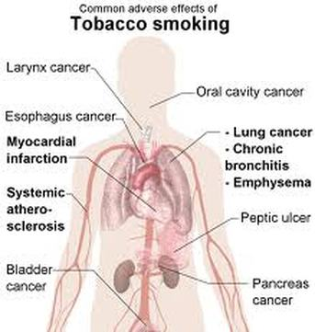
Across The Body

Slide 7
Alcohol

Slide 8
Percentage Per Drink

Slide 9
One Drink Equals

Slide 10
Liver

Slide 11
Across The Body

Slide 12
Alcohol Poisoning

